Slide 1
Title x clinic locations and their relation to income in Michigan
Elizabeth chambers and harshpriya gaikwad

Slide 2
The title x family planning program
Federal grant program dedicated to family planning services
Reproductive health services for lower income communities
Is there a relationship between locations of Title X clinics and median household income in Michigan?
Notes:
The Title X Family Planning program is the only federal grant program dedicated to providing affordable birth control and reproductive health care. In recent years, family planning organizations have been facing much criticism. Rather than cutting services criticized by the government, many large organizations are opting out of the program. Has this led to the loss of family planning clinics in lower income communities? The nature of the Title X program should place Title X clinics in communities where lower income individuals will have access to them. This research explores the relationship between family planning clinics and median household income.

Slide 3
Data
Census Bureau API
MDHHS Title X Family Planning Clinic Directory
Google Maps API
Notes:
The data used for this project was taken from the United States Census Bureau API as well as the Michigan Department of Health & Human Services. The data extracted from the United States Census Bureau was from the “Small Area Income and Poverty Estimates (SAIPE)” API, which provides the best single-year estimates of median household income. The locations of family planning facilities in Michigan were taken from the Michigan Department of Health and Human Services Family Planning Clinic Directory. In addition to this data, the Google Maps API was used in order to geocode the locations of Title X Facilities as well as counties in Michigan.

Slide 4
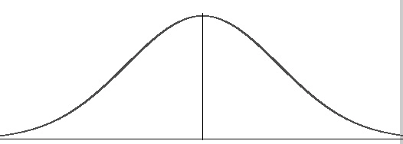
procedure
Assume normal distribution
1st Quartile: <= 47,482
3rd Quartile >= 57,626
Notes:
After gathering income data from the Census Bureau API – assuming a normal distribution – the 1st and 3rd quartile were determined using the summary() function, in order to determine a threshold for which counties in Michigan should be considered to have lower income and which should be considered to have higher income. These bounds were found to be less than or equal to $47,482 annually and greater than or equal to $57,626 annually.

Slide 5
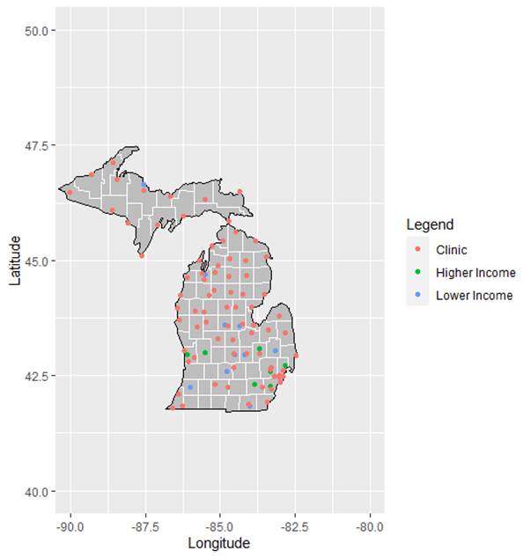
Mapping Michigan
Notes:
This map was created by utilizing the ggplot package, the mutate_geocode() function provided by the Google Maps API to geocode the coordinates of the counties in Michigan which fall into the 1st and 3rd quartile, as well as data provided by the maps and mapsdata packages. Title X clinic locations are represented by red dots, counties which have a “higher” median income that falls within the 3rd quartile are represented by green dots and counties which have a “lower” median income, falling within the 1st quartile are represented by blue dots. As you can see, the locations of Title X facilities appear to be uniformly distributed, with a few clusters around higher-income areas (which coincidentally happen to be where some of Michigan’s largest cities – aka Detroit and Grand Rapids- are).

Slide 6
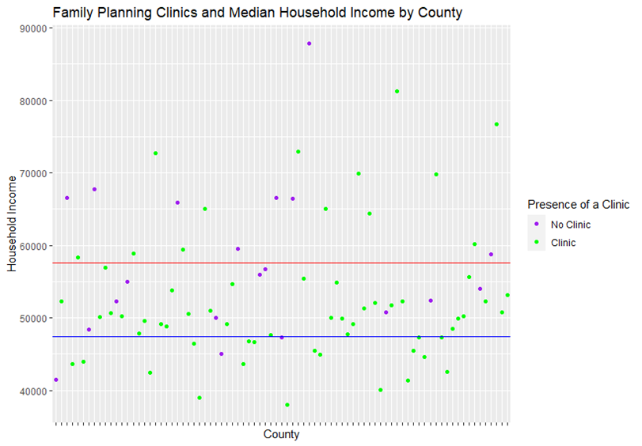
Visualizing income and clinic locations
Notes:
In order to better understand the relationship between income and locations of family planning clinics, a scatterplot depicting median household income for every county in Michigan was plotted. The horizontal lines represent the 1st (blue) and 3rd (red) quartile. Counties which have a Title X clinic are colored green while counties without a Title X clinic are colored purple. From this graph we can see that the population proportion of clinics located in a county where the median income falls in the 1st quartile is 18/79 or 22.7%. We can also see that the population proportion of clinics located in a county where the median income falls in the 3rd quartile is only 13/79 or 16.4%.

Slide 7
Analytical tests
Point bi-serial correlation
Cor: -0.2229211
P-value: 0.0428
Logistic Regression
P-value of household income variable: 0.0354
Notes:
The analytical tests used to determine if there is a relationship between locations of title x facilities and median household income were a point bi-serial correlation test and a logistic regression test. The point bi-serial test shows us that the relationship between clinic locations and income has a weak negative linear relationship (since the coefficient is closer to 0 than 1), meaning that when a county has a title x clinic, the median income of that county tends to be lower. In addition to this, with a 95% confidence interval, we can conclude that the relationship between the two variables is statistically significant because the p-value is 0.0428 (<0.05). The logistic regression test further solidifies the statistical significance of the relationship, due to the p-value also being <0.05 (0.0354), this tells us that the income of a county is significant in predicting whether or not there will be a Title X facility in that county.

Slide 8
conclusions
The relationship between income and locations of family planning clinics is statistically significant
The correlation between these variables is weak
The Title X Family Planning Program is effective
Notes:
Considering the results of the point-biserial correlation test and the logistic regression test, as well as the graphical interpretations of the data, we can conclude that the relationship between locations of Title X clinics and median household income in Michigan is statistically significant, even though the correlation between the two is weak. We can also conclude that since the correlation factor is negative, that as income level decreases, the chances of the county having a title x facility goes up. Because of this correlation, we can conclude that the Title X Family Planning Program is effective in providing individuals with access to affordable reproductive healthcare. Affordable reproductive healthcare appears to be uniformly distributed throughout Michigan, with a slight bias favoring communities with lower income, which is exactly what the Title X grant program aims to do: help everyone have access to affordable reproductive health care.

